Slide 1

Sri Syala Educational Trust (R), Bheemasamudra
G M UNIVERSITY, DAVANGERE
School of Computer Science T Technology (SCST)
DEPARTMENT OF CS-CYBER SECURITY & CS-INFORMATION SECURITY
A Project Synopsis Presentation on
“AI-Driven Property Security & Verification System”
Presented By:
Nikhil Suthar U24E01IY043
Kulkarni Atharva U24E01IY036
Ujjwal Kumar U24E01IY076
Naveen N D U24E01IY040
Under Guidance of:
Dr. Rachana P G
Assistant Professor,
Dept. of CY & IY
Project Coordinator:
Mr. Nandan Kurdekar
Assistant Professor,
Dept. of CY & IY
Program Coordinator.
Mrs. Nayana K
Associate Professor &HOD Dept. of CY & IY

Slide 2






Photo
Guide Name :Dr. Rachana P G
TEAM-MATES
Naveen N D Kulkarni Atharva
Ujjwal Kumar
Nikhil Suthar

Slide 3

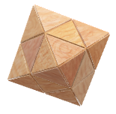
Contents
1. Introduction
2. Literature Review
3. Problem Statement
4. Objectives
5. Software and Hardware Requirements
6. Flowchart / Methodology
7. Expected Outcome
8. Conclusion
9. References

Slide 4

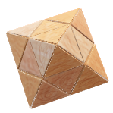
Introduction
Property verification is a multi-stakeholder process involving buyers, sellers, builders/developers, property agents, lawyers, banks/NBFCs, and government authorities.
It requires checking multiple legal and ownership documents such as sale deeds, RTC/Pahani, mutation records, encumbrance certificates, khata and tax receipts.
Traditional verification involves manual document checking and cross-referencing, making the process time-consuming and susceptible to missed inconsistencies.
AI can analyze, compare, and cross-verify property documents to identify inconsistencies, missing information, and potential risks more efficiently.

Slide 5


Literature Review
Sl. No. | Research / Study | Author(s) | Year | Technology Adopted
1 | Blockchain for Real Estate Provenance | Abualhamayl et al. | 2024 | Blockchain, Smart Contracts
2 | Intelligent Land Record Digitization & Validation | Mrs. Nayana | 2026 | AI, OCR, NLP
3 | Mapping the Bounds for Integration of Blockchain Titles | Galloway et al. | 2024 | Blockchain, Land Administration
4 | Document Data Matching for Blockchain-Supported Real Estate | Lin, Dias & Correia | 2025 | OCR, NLP, Blockchain
5 | Hybrid AI-Blockchain Framework for Secure Land Records | S. R. Nagaraja & R. Shushma | 2025 | OCR, NER, AI, Blockchain
6 | Asset Guru: Digital Framework for Property Data Governance | Sumaira A. Shaikh et al. | 2026 | AI, GIS, Digital Property Records

Slide 6




Idea and Approach
Problem Statement
“To address the inefficiencies and risks of manual property verification by enabling automated analysis and cross-verification of property documents.”
AI-Based Evaluation
“AI analyzes property documents, extracts key details, and cross-verifies them to detect inconsistencies and potential risks.”
Technology Design
The system integrates a user-friendly frontend, securebackend , database,
OCR/document processing , AI-based verification, and role-based access control to provide automated and secure property verification.
Future Expansion
The system can be enhanced with government-record integration, advanced fraud detection, blockchain-based document verification, multilingual support, and mobile application support.

Slide 7

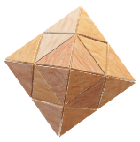
Objectives
To design a secure and user-friendly system for property document verification.
To develop an AI-based document analysis and cross-verification system to identify mismatches, missing information, and potential risks.
To implement automated risk detection and verification report generation for faster and more reliable property verification.

Slide 8

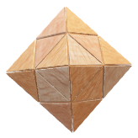
Requirements
Hardware Requirements
Modern dual-core processor or better
Software Requirements
Frontend: HTML, CSS, JavaScript, PHP
8 GB RAM recommended
Backend: Python (FastAPI)
Database: MongoDB
Tools & Libraries:OCR + AI / LLM, OTP authentication and role-based access.
10 GB or more free storage
Optional cloud/GPU resources for larger AI workloads

Slide 9
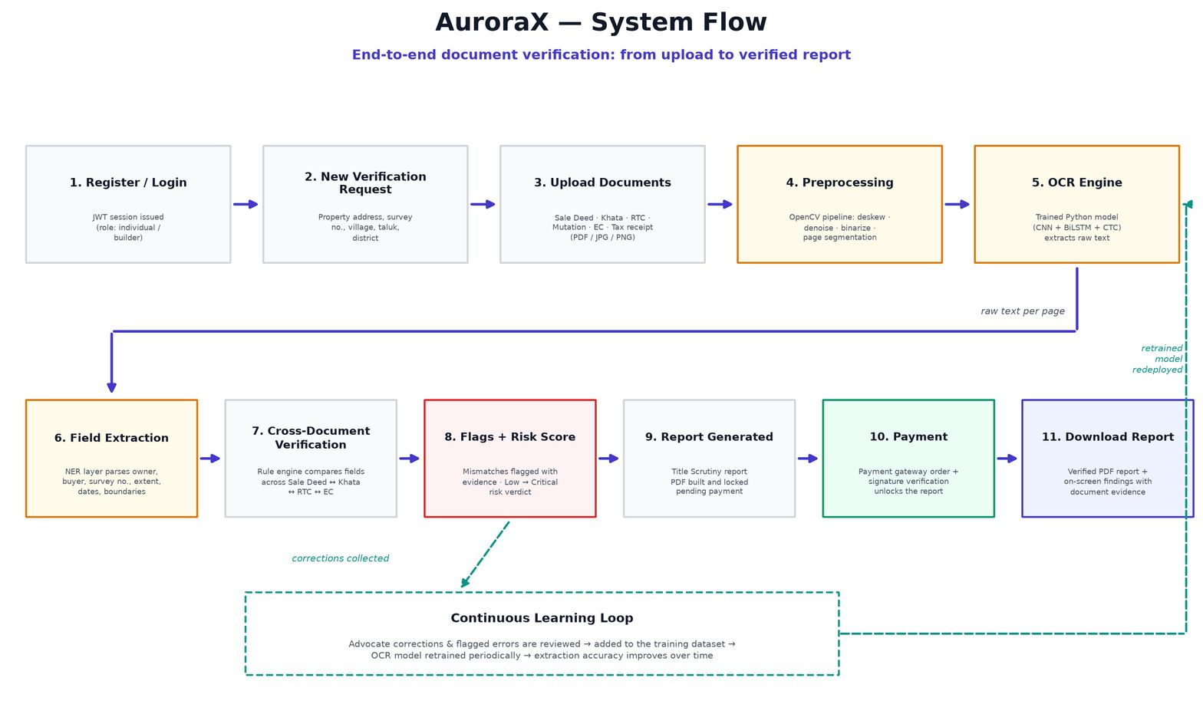


Slide 10
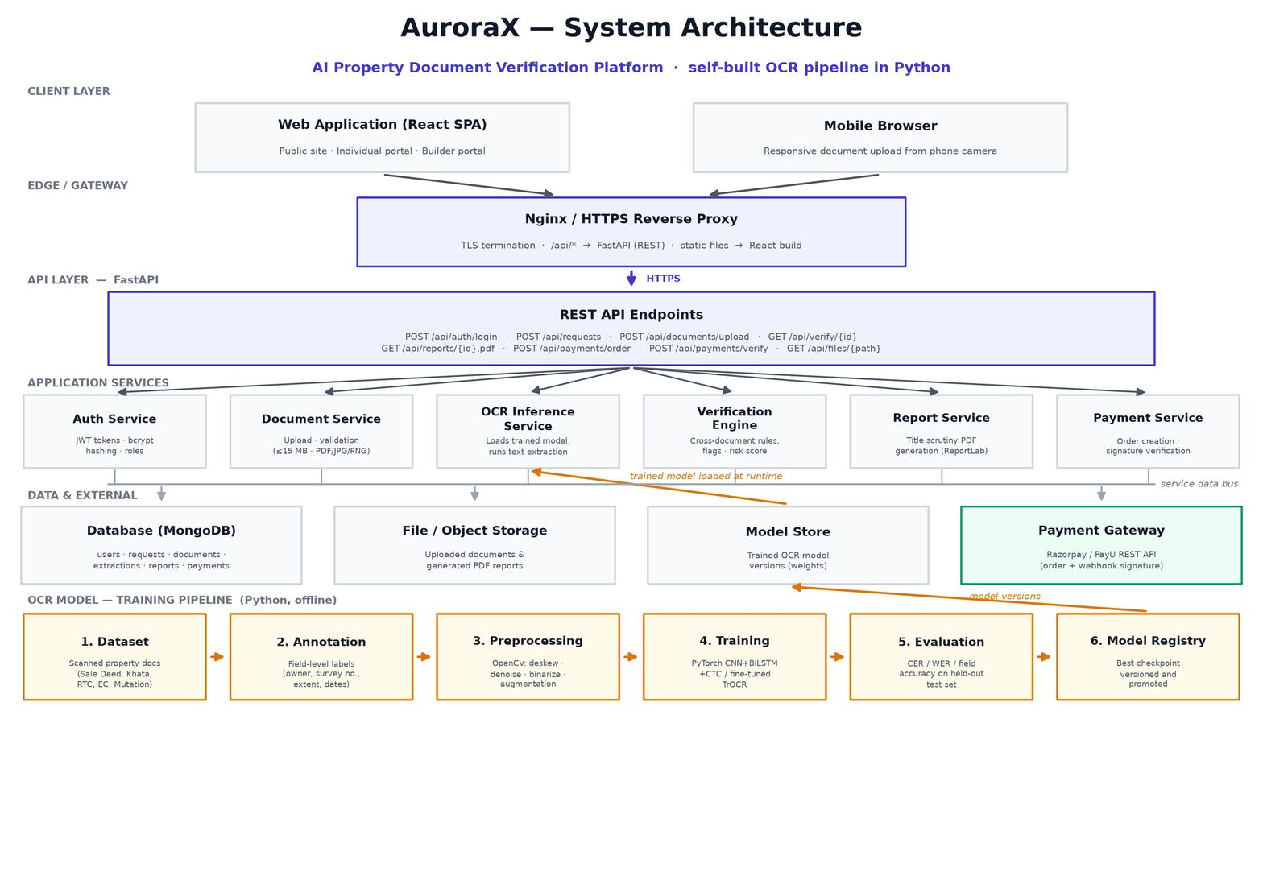
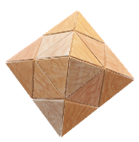

Slide 11

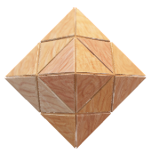
Expected Outcome
Faster preliminary property-document verification.
Reduced repetitive manual document-reading effort.
Automatic identification of missing information and mismatches.
Consistent risk flagging with severity and explanation.
Standardized verification report for buyers, banks, builders and lawyers.
Improved transparency and safer property decision-making.

Slide 12

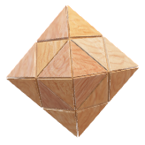
Conclusion
The proposed system combines property documents into one verification workflow.
AI assists with document reading, information extraction and cross-verification.
Security features help protect users and property documents.
Automated reports make verification results easier to review and share.
The system supports professional due diligence and does not replace qualified legal review.
Overall, it aims to make property verification faster, secure and reliable.

Slide 13


Reference
Abualhamayl et al. — Blockchain for Real Estate Provenance, 2024.
Mrs. Nayana — Intelligent Land Record Digitization & Validation, 2026.
Galloway et al. — Mapping the Bounds for Integration of Blockchain Titles, 2024.
Lin, Dias & Correia — Document Data Matching for Blockchain-Supported Real Estate, 2025.
S. R. Nagaraja & R. Shushma — Hybrid AI-Blockchain Framework for Secure Land Records, 2025.
Sumaira A. Shaikh et al. — Asset Guru: Digital Framework for Property Data Governance, 2026.

Slide 14

THANK YOU
AuroraX
2026/09/22

